Slide 1

iSwipe: : connecting hungry students to affordable meal swipes
Motivation: frustration of having too many meal swipes
Steps taken so far: calculated distance from locations of RPI GPS with a connected user’s Dweet for an automated email notification

Slide 2
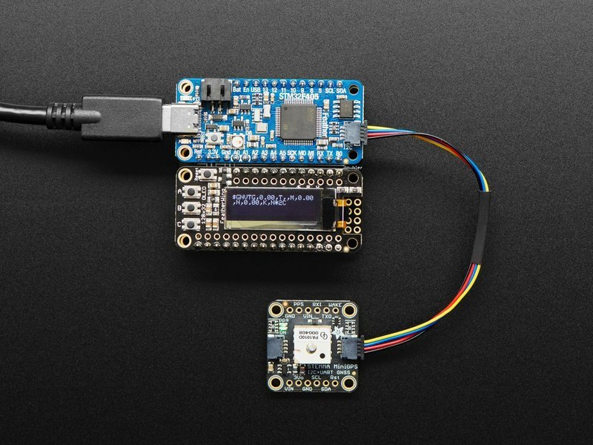
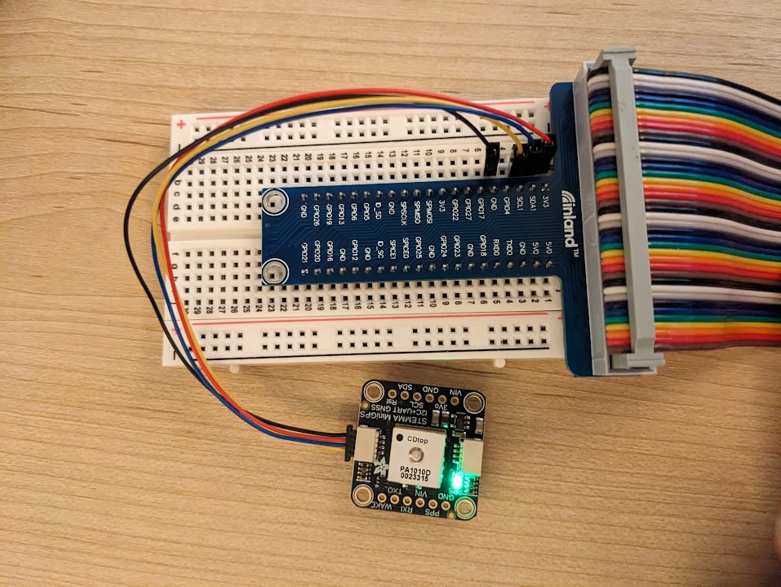
Hardware
Raspberry Pi
Adafruit Mini GPS PA1010D Module
STEMMA Connections
3V
SDA (Serial Data Line)
SCL (Serial Clock Line)
Ground

Slide 3
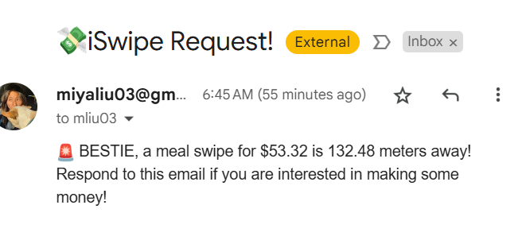
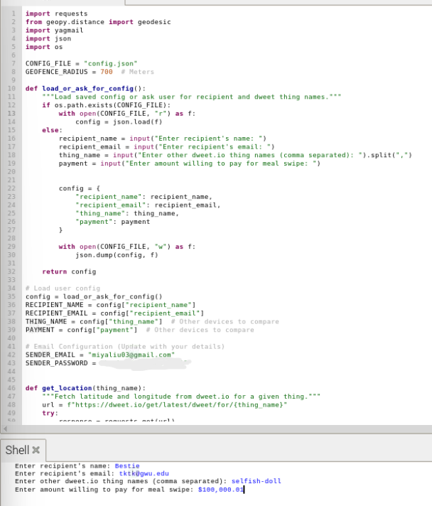
3-Layer IoT Model
Application | Email notification | The email contains the price offered and prompts the receiver to respond to the email if they would like to provide a meal swipe
Network | LAN cable, internet | The code then calculates the distance between the two and if is under a certain distance, it sends them an email.
Perception | GPS, Dweet.io, User input | User inputs amount they’re willing to pay for a meal swipe, the receiver’s name, email, and Dweet name The RPI GPS and Dweet.io reads their coordinates.

Slide 4
Conclusions
There are a lot of resources for these types of projects — the trick is how to use them effectively and efficiently
There is probably an easier way to do your task that will produce the same quality of result if not higher
The project completes the original goal, just differently than I had anticipated

Slide 5
Next steps
Clean up UI
Clean up GPS system and packaging
Add option for multiple email-Dweet things combinations
Accuracy characterization

